Slide 1
Examining Disney Magic
An Attempt to Predict Feature Film Success
By: Ben Roberts
Notes:
Hey yall, today’s presentation is an examination or an attempt to understand a bit of the Disney Magic. My Name is Ben Roberts, so let’s dive in.

Slide 2

Goals &
Objectives
Context & Scope
A tool to help film makers
Data & Sources
This project seeks to understand if the previous performance of the Walt Disney Company, the Directors, and Writers of Disney movies can be used to estimate the success of future films. This is just the first phase of a larger project that will hopefully lead to the creation of a tool for future film-makers could leverage to help create successful movie projects in the future.
Process / Analysis
Conclusions
Next Steps
Notes:
This project seeks to understand if the previous performance of the Walt Disney Company, previous performance of the Disney film Directors and Writers of Disney movies can be used to estimate the success of future films. This is just the first phase of a larger project that will hopefully lead to the creation of a tool for future film-makers could leverage to help create successful movie projects in the future.
So I’m going to walk you through a little context and outline the scope of this project, then we’ll discuss the data and where it came from, I’ll walk you through the process we used and how we did our analysis, and finally we’ll take a look at the conclusions and discuss some next steps.

Slide 3
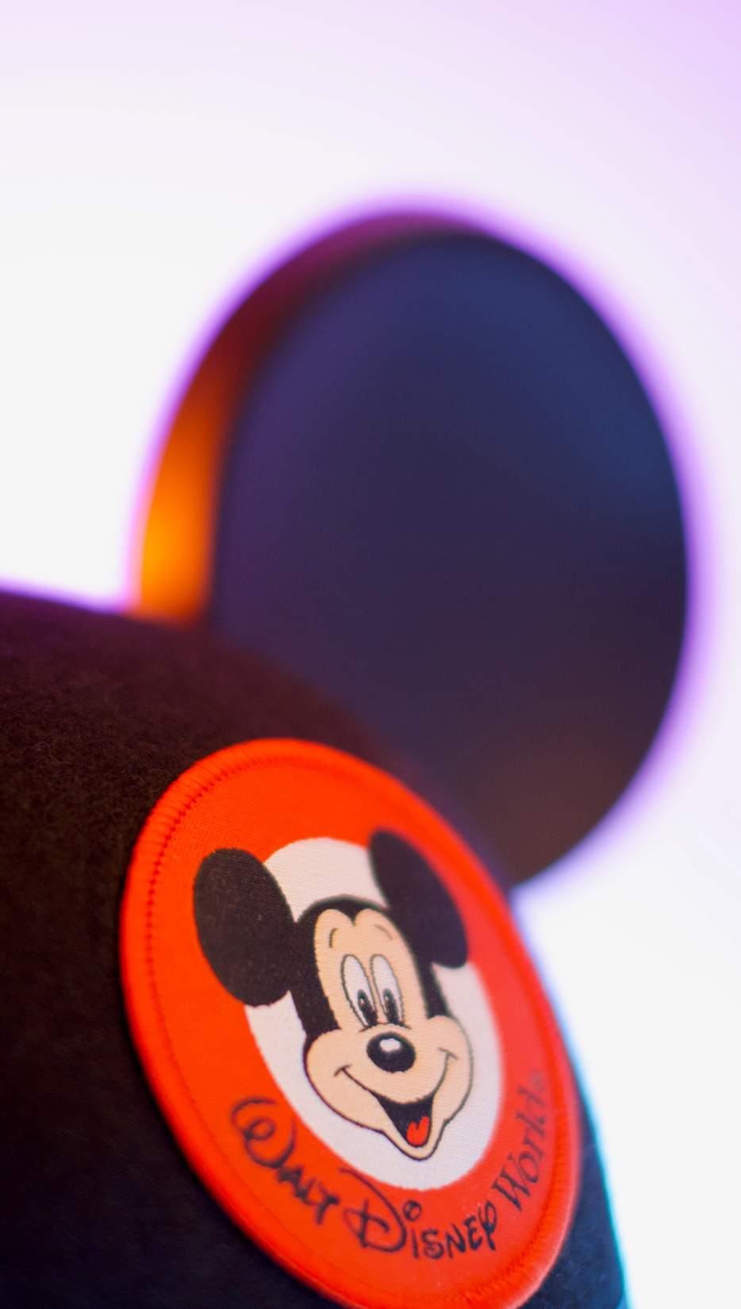

Context
657 Disney Films
12 Disney Theme Parks
4 Disney Cruise Ships
190,000 Employees
$1.7B 2021 Est. Revenue
1937 – Snow White and The Seven Dwarfs
$1.5M Budget
2022 – Dr Strange in the Multiverse of Madness
$200M Budget Est.
WaltDisneyStyle
Notes:
According to Disney.com, as of April 2022, 657 Disney movies have been released since the first Disney feature film, Snow White and The Seven Dwarfs, premiered in 1937. Since that time, the Walt Disney Company has expanded in many different directions. From theme parks, to TV, music, merchandise, cruise ships, venture capital, and streaming services, today The Walt Disney Company is truly a global conglomerate. But it all started with the movies and in 2021, Disney and it's subsidiaries generated a box office revenue of $ 1.17 Billion dollars. Understanding just a small piece of the Disney magic that affects that revenue could have enormous implications. From Snow White and it’s $1.5M budget, to the latest Marvel movie with an estimated budget of $200M, with this project we hope to understand if past performance could be indicative of future results.

Slide 4



Scope
Full Length Features
No Shorts
No Direct to Video
No Direct to Streaming
Include Pixar
Include Live Action/Hybrids
Include Musicals, Dramas, Comedy, Documentaries, and more
Notes:
This project focuses on full-length, feature releases from The Walt Disney Company. We are excluding Disney produced shorts, TV Shows, Direct to Video releases, and Direct to Streaming releases. In some cases, the films considered were produced by the Walt Disney Company or its subsidiaries, in other cases, they were distributed by The Walt Disney Company or its subsidiaries. We did not the limit the scope to a specific genre or type of film. This project considered live-action, animation, and hybrid films. We also considered musicals, dramas, comedies, documentaries and more so long as they were full-length feature film releases.

Slide 5

Data
Films List by Disney.com
Film Meta Stats by IMDB.com
Film Principals by IMDB.com
Notes:
With the expectation that this projects represents just the first phase, a wide net was originally cast for this project. Ultimately this first phase used film lists from Disney.com, D23 (the official Disney fan club), and Wikipedia, as well as film data given to us by IMDB.com and additional film data scraped from IMDB.com. Additionally, 33 scripts from different Disney films were found, as well as lyrics to more than 790 Disney songs. Ultimately, the scripts and lyrics data will be used as part of future project phases. Data from 10 similar projects by other authors was also gathered and considered but not used in this phase.

Slide 6

Process
Film Stats
Release date, Budget, Revenue, IMDB Ratings
Principals Stats
Previous films, previous ratings,
Notes:
After gathering a few different lists of Disney movies from different sources, there was a lot of variation discovered. Ultimately the decision was made to work from the list of movies gathered from Disney.com. Data provided by IMDB was then combined with the movie list. Working with more than 8 million titles, trying to narrow down the IMDB data involved comparing a lot of text and manually checking a lot of duplicate titles.
Once the list was back down to a reasonable number of suspected Disney films, a number of titles including TV Shows, similarly titled films, Disney Shorts and Compilations, and Direct to Video Releases among others were removed. Then a scrape of IMDB was performed to gathered more data that was not originally provided.
Next, a list of Directors and Writers was created and their performance histories were gathered, then combined with the films list. After some EDA and Visualizations, models were created and predictions generated.

Slide 7
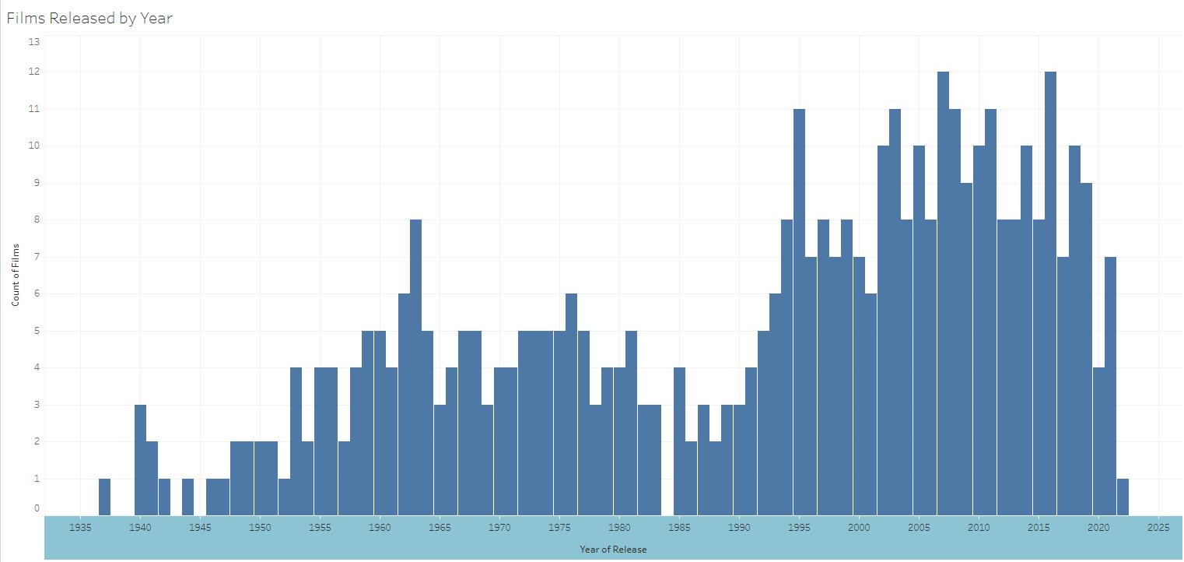
Films Released by Year
Notes:
So the analysis of data just prior to modeling lead to some interesting results. For example, this is graph shows us the number of titles released each year since 1937. You’ll notice that there is lull in the 1980 followed by a resurgence in the mid-1990’s. This resurgence is often referred to as the Disney Renaissance. You’ll also notice in the early year 1 or 2 releases a year was pretty standard, often with a year or so in between due to the length of time it took to produce such films. Yo umay also notice the gap in 1984 where it appears that no films were released. There were in fact 2 films released that year however, there was not enough data available on those films to be considered for this project. Data scarcity and uneven availability was problem we had to contend with over and over and over again.

Slide 8
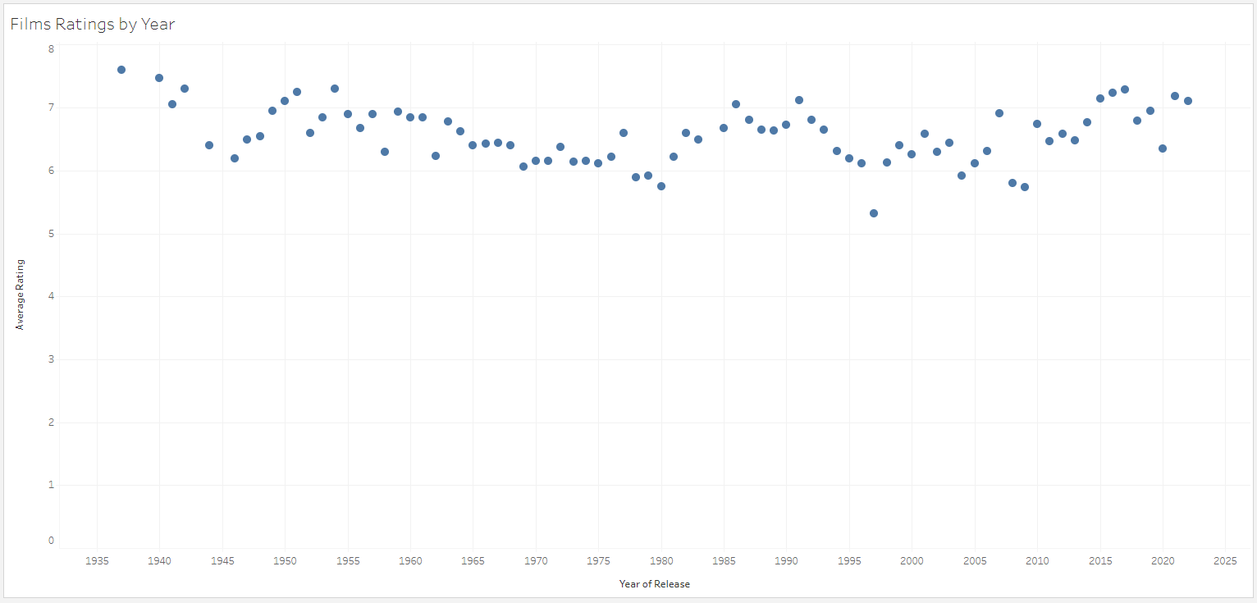
Average Rating per Year
Notes:
This chart is one of my favorites. This shows us the IMDB user ratings, on average, for each year in which Disney films were produced. IMDB was founded in October of 1990, which is just a bit to the right of center on this chart. Meaning that ratings of feature films prior to 1990 are not ratings from the time of release but through a historical lenses. Snow white in 1937 and Pinocchio in 1940 being the highest rated, though neither film turned a profit in it’s initial release meaning there is an awful lot of nostalgia in these ratings. People cared so much about these films that they would venture back nearly 60 years to leave a rating and review. Now this chart shows us the AVERAGE rating per year

Slide 9
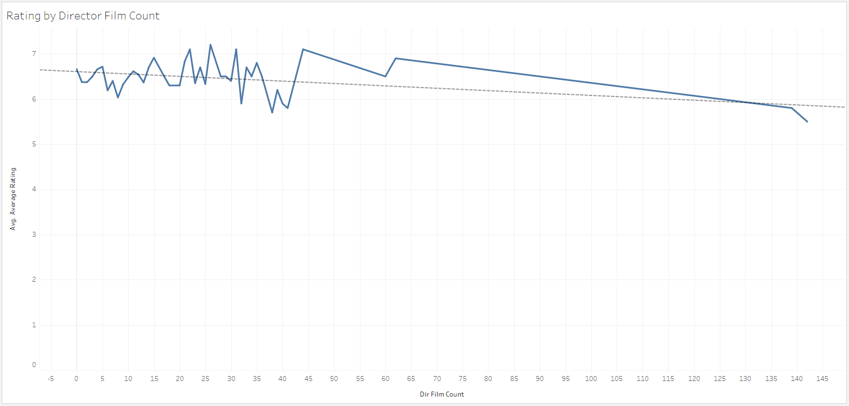
Average Rating by Director
Notes:
This particular chart shocked me. I dove back into the data manually, to figure out what was happening. This chart shows us the average IMDB Rating for Disney Directors for the films they Directed PRIOR to the Subject Disney Film. The first thing we see is that there were two Directors with more than 135 feature films Directed prior to their Disney releases. This is not an error. There were a few directors of early Disney films with more than 40, 50, 60, and yes, more than 130 Directed feature films under their belts. We’ve also added a trend line that would suggest that the number of films directed prior to the Subject Film might actually lead to slightly lower IMDB user ratings.

Slide 10
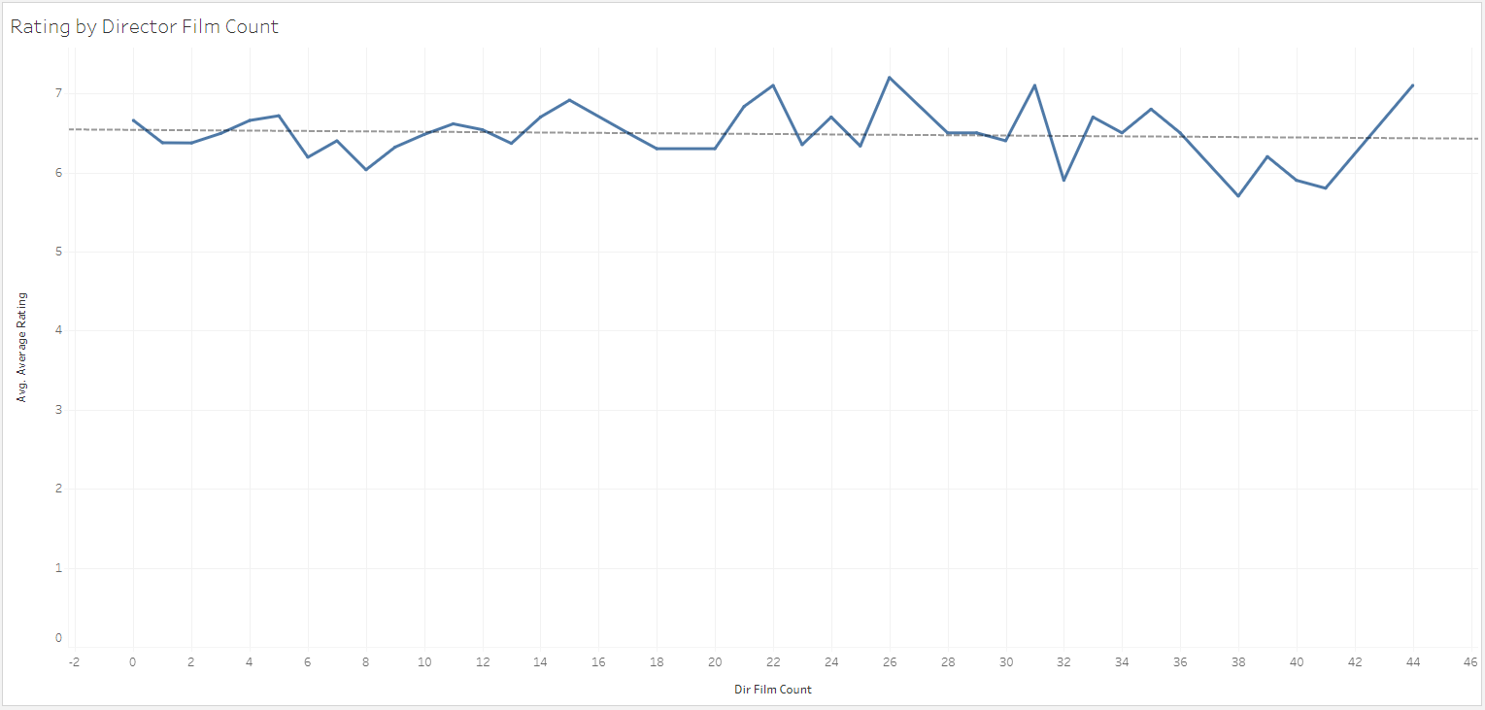
Average Rating by Film Count
Notes:
When we remove the four directors with more than 50 films Directed, we can see that the trend line flattens out. Meaning that a director with NO previous directorial experience could likely score as high or higher than a director with 5 or 6 films previous directed. While the trend for IMDB is relatively flat,

Slide 11
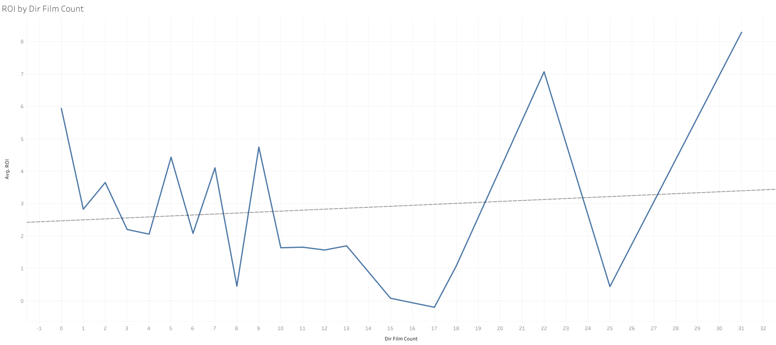
ROI by Previous Film Counts
Notes:
When we look at the ROI of each subject film, based on the number of films previous released, we see very little correlation, through a slightly positive trend. In other words, when looking at the slide and the previous slide, it’s clear to see that the User IMDB rating does not corelate well to the ROI of the film. And we looked at ROI vs worldwide revenue because a 10% return is a 10% return whether it comes in 1940 or in 2020. However, a million dollars in profit in 1940 was WAY more meaningful than a million dollar return in 2020.

Slide 12
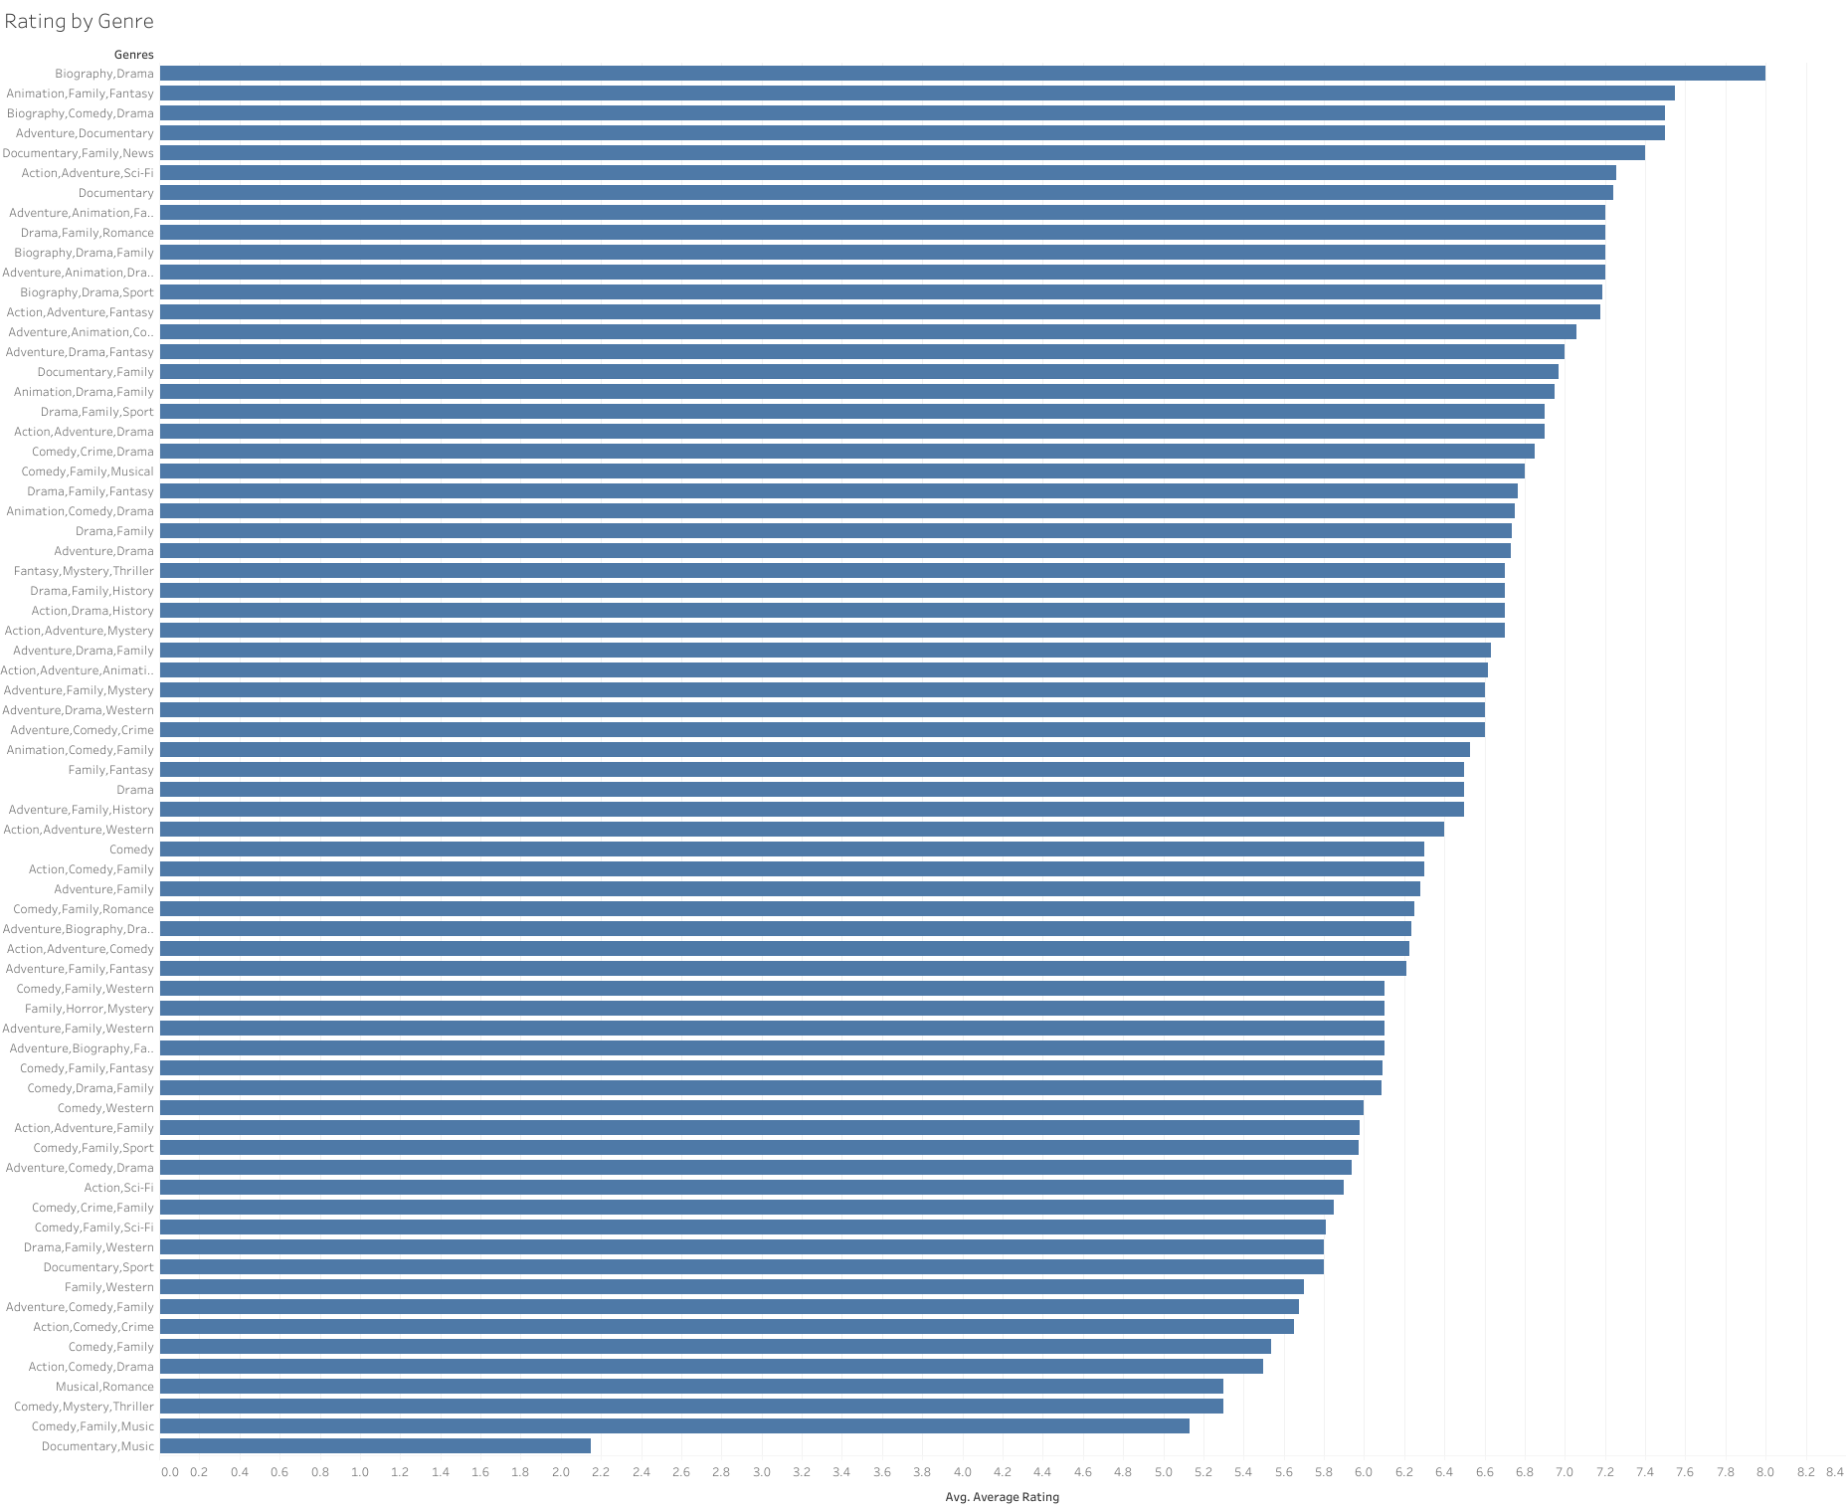
Average Rating by Genre
Notes:
Bare with me, I know chart is super tiny, but what we’re looking at is the IMDB user rating by genre. 5 of the top 7 genres included Biography or Documentaries while…

Slide 13
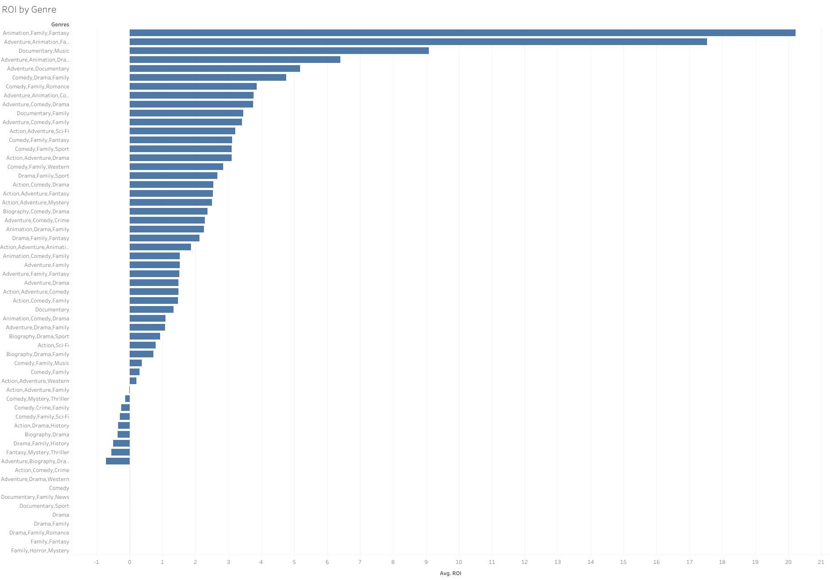
Analysis
Notes:
Those films tend to do less well from a financial standpoint. Action fantasy adventure films to produce the highest ROI, return on investment. Probably nobody is surprised that those genres include the latest marvel movies.

Slide 14
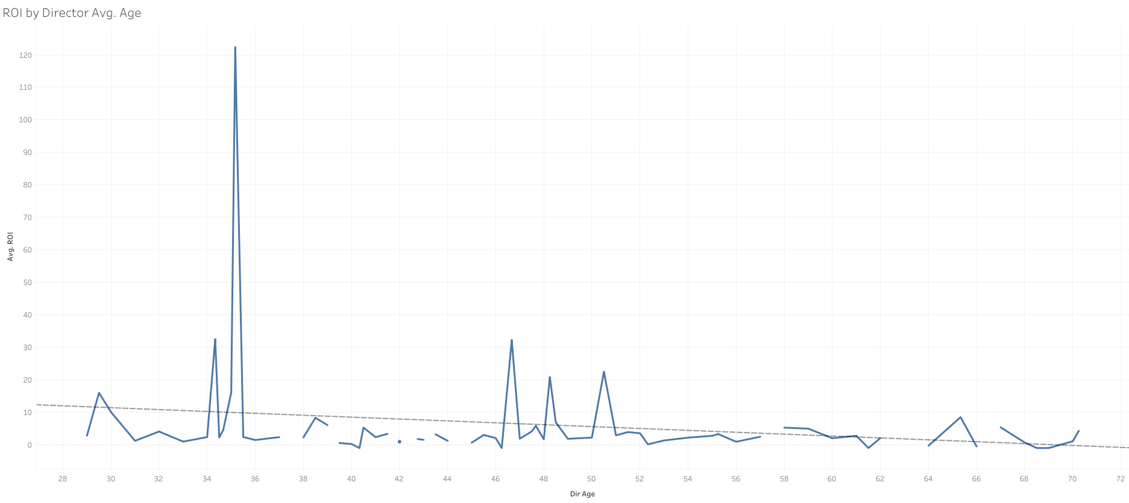
Analysis
Notes:
This chart I also found interesting; This shows us the ROI of each film as compared to the age of the Director at the time of release. There is definitely a sweet spot for director in their mid30’s and in their late 40’s with sporadic films released by directors in their late 30’s and early 40’s. I’m not sure why this is but it would be something fun to dig in to. I suspect that at that point in life, having reached a level of sucees, director take time to focus on other things and then come back to film direction a little later in life.

Slide 15
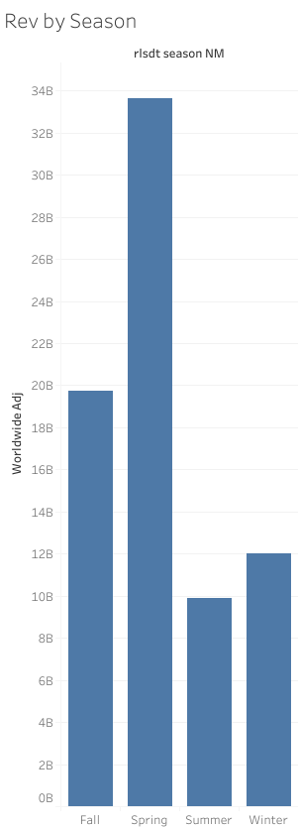
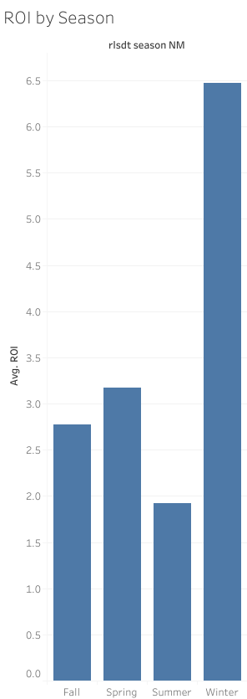
Analysis
Notes:
This chart also surprised me. As movie goers, when we think of the movie going season, we often think about the summer movie season or the holiday movie season. But from a business perspective, we see the highest revenue in the spring, with summer and winter bringing in the least revenue. However, the highest return on investment seems to be films released in winter.

Slide 16
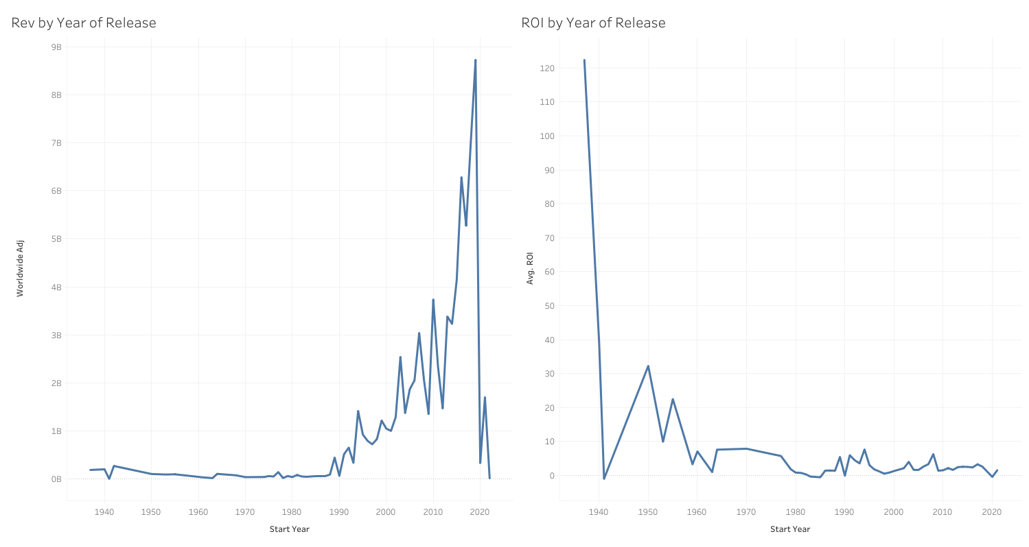
Analysis
Notes:
And lastly, this chart made me laugh and got me to understand that there are some major flaws in our data. This chart would seem to indicate that movies today have a much lower ROI than movies released in the early days of the Walt Disney Company. However, in 1937 Disney released Snow White and the 7 dwarfs on a budget of $1.5M and has since gone on to earn more than $184M. So that is an astronomical ROI but, not all films have enjoyed 80 years worth of nostalgia to draw on and that is total revenue of $184M over the last 80 year. The film initially lost money with a debut of only $600k. So when we look at long term success of a film, we might want to consider ROI over time, and not just the initial release.

Slide 17
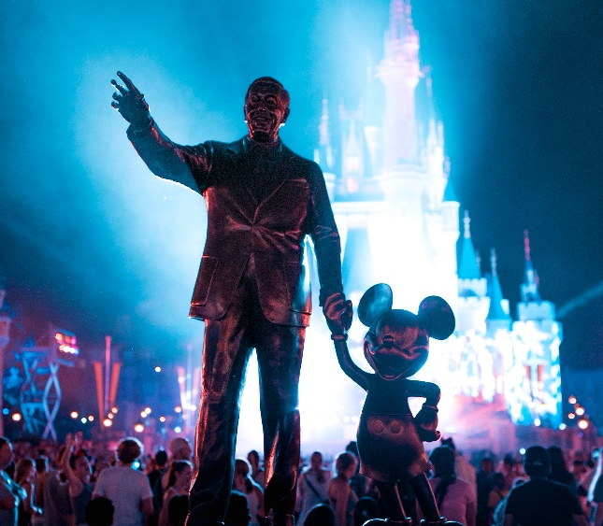



Modeling
Linear Regression
Decision Tree
IMDB Score
Lasso Model
CV .396
RMSE .776
Wordlwide Revenue
Lasso Model
CV .396
RMSE .776
Adaboost
KNN
Notes:
After data cleaning and exploratory data analysis the following regression models were used to predict the IMDB User Rating for each title:
1. Linear Regression
2. Decision Tree Regressor
3. Bagged Tree Regressor
4. Random Forest Regressor
5. Adaboost regressor
6. KNN Regressor
7. Lasso
8. Ridge
The baseline model, the mean IMDB User Rating, produced a Root Mean Squared Error of 0.947%. The root mean squared error indiactes that the errors are about 0.947% off from the actual IMDB Rating.
Additionally, the same types of models were used to predict the Worldwide Revenue of each title. The baseline model for revenue produced an RMSE of 359,926,713%. The root mean squared error indiactes that the errors are about 359% off from the actual Revenue. Given the vast difference between the min and max reveunes, this odd result isn't too surprising.

Slide 18
Our Predictions
Dr Strange in the Multiverse of Madness
IMDB Score: 6.63
Worldwide Revenue: $294, 513, 986
The Bob’s Burgers Movie
IMDB Score: 6.37
Worldwide Revenue: $45,963,783
WaltDisneyStyle
Notes:
After comparing and tuning the models, Lasso was deemed the best fit as it produced the best Cross Val scores and a reasonably small Root Mean Squared error for the test data.
We were able to predict the IMDB User Rating and Worldwide Revenue for two upcoming releases, Doctor Strange in the Multiverse of Madness and The Bob's Burgers Movie, both due to be released in May of 2022. Doctor Strange is predicted to have an IMDB rating of 6.63 with Worldwide Revenue of \\$294 294,513,986. The Bob's Burgers Movie is predicated to have an IMDB rating of 6.37 with Worldwide Revenue of \\$45,963,783. It remains to be seen how accurate these predications will be.

Slide 19
Additional
Features
&
Next Steps
Budget and Revenue Gaps
Film Maker History Gaps
Source Material / Original Authors
Leading Characters / Supporting Characters / Villains
Actor Track Records
Special Effects
Production Company / Distribution
Marketing / Promotional Efforts and Budgets
Easy to Use App
Notes:
Data availability was uneven amongst films and features of interest, forcing us to drop a few observations, consider different features, and different targets. With more time there are a number of things that could be done to improve the model and the results.
- Budget and Revenue numbers were not readily available from IMDB for each Disney film. Nor were they available for each film in the Director's and Wirter's history, meaning our previous performance indicators may not be complete or 100% accurate. With more time, the missing budget and revenue numbers may be sourced elsewhere.
- Additional features could be valuable in analyzing IMDB User Ratings as well as Revenue numbers. Currently, the model does not take in to account source material, or source authors. It also does not account for Disney having produced versus distributed the film.
- While there is some accounting for live-action vs animation, movie plot elements are not considered. With more time, I'd like to attempt to categorize leading characters/supporting roles (human vs animal vs other, male/female, young/old, etc), the presence of a villain or villains, continuous story line vs series of adventures, presence of absence of a love interest, main character family traits and how prominently family members are featured, atc.
- This model does account for the track record of the directors and writers of the film, it does not account for the track records of the principal actors. Also, there are some gaps in the data provided by IMDB. With more time, those gaps could be researched and filled in making the model more complete.
- For those films featuring songs, the writers and composers track records and demographics could be considered.
- For those films featuring action sequences and/or special effects, the track records of those producing the effects could also be considered. As well as the amount of runtime dedicated to those sequences.
- Marketing and Promotional efforts are not accounted for in this analysis either. Marketing campaign, or marketing spend as percent of total budget. If toys or merchandise were produced, in what quantities, in which price ranges, how widely available, etc. Additionally, partnerships and collaborations with companies such as McDonald's (i.e. Happy Meals) are not considered.
- Script elements such as the number of words or sentiment of the film is also not considered and may be interesting to look at as well.
- While the code currently exists to create predicitions for future releases, it's not very user friendly. A tool should be created allowing the user to enter specific parameters (budget, writers, directors, estimated release date, and additional feature data), and receive an estimated IMDB User Rating, Revenue Numbers, and ROI predictions.

